Slide 1
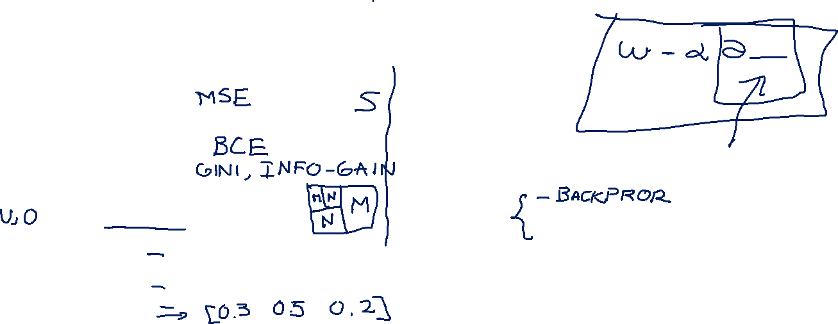
Machine Learning
Gradient Descent Algorithm
Linear Regression
Non-Linear Regression
Logistic Regression
Decision Trees
Regression Trees
Classification Trees
Model complexity and ensemble models
Clustering Algorithms
K-Means
Hierarchical clustering
DB-Scan
Mean Shift
GMM
Support Vector Machine
Datasets
Breast Cancer Wisconsin
MIMIC-III
Framingham Heart Study
Alzheimer’s Disease Neuroimaging Initiative
Drug discovery
Microbiome
Deep Learning
MLP
CNN
CNN Arquitectures
Autoencoders
E: Transfer learning y fine tunning
Recurrent Neural Networks
VAE
GAN
Transformers
Diffusion Models
Paper + Implementation

Slide 2
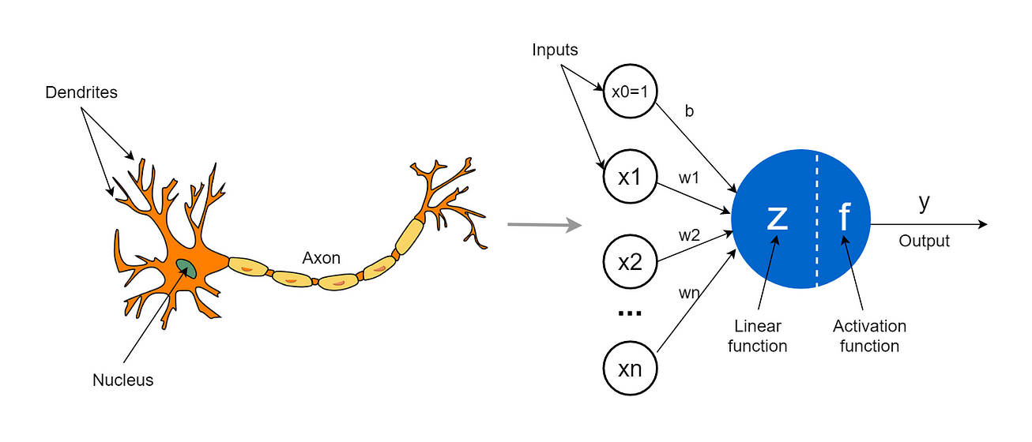
my humble ML course

Slide 3
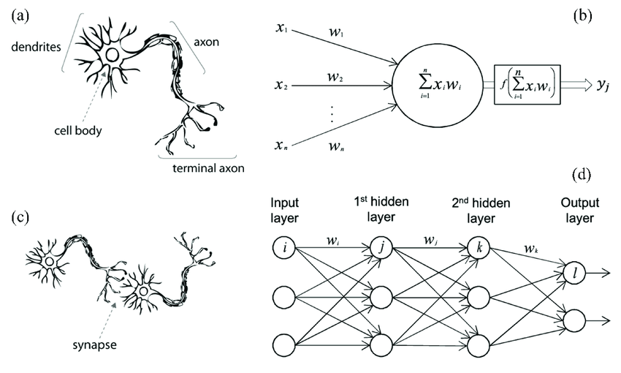
my humble ML course

Slide 4
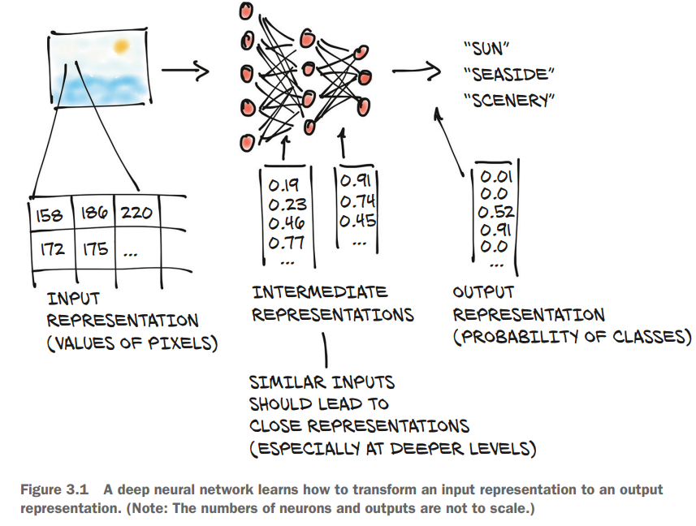
my humble ML course

Slide 5
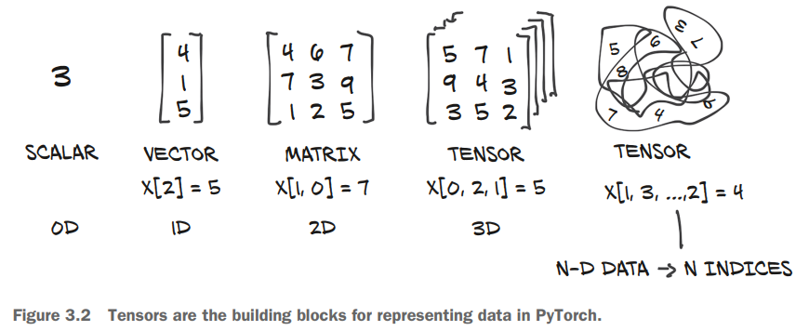
my humble ML course

Slide 6
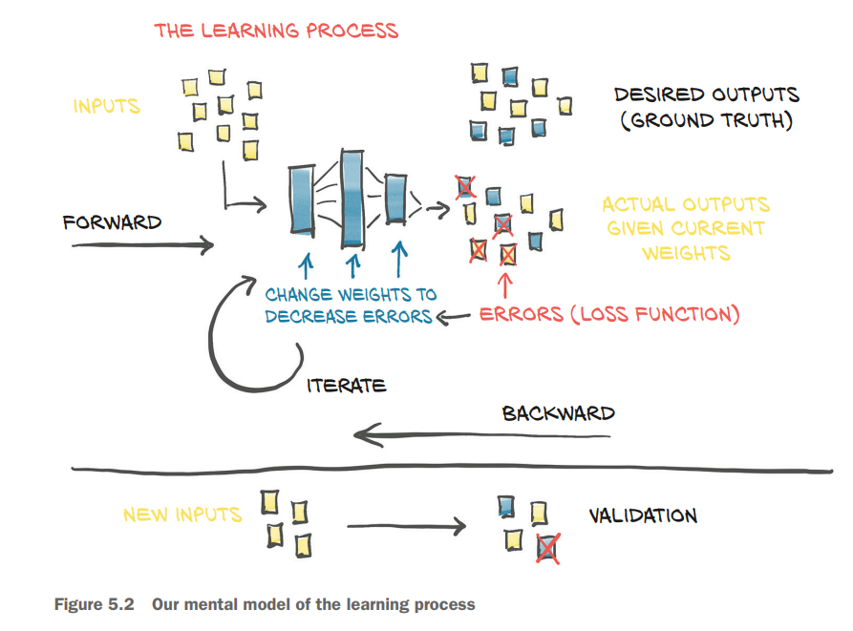
my humble ML course

Slide 7
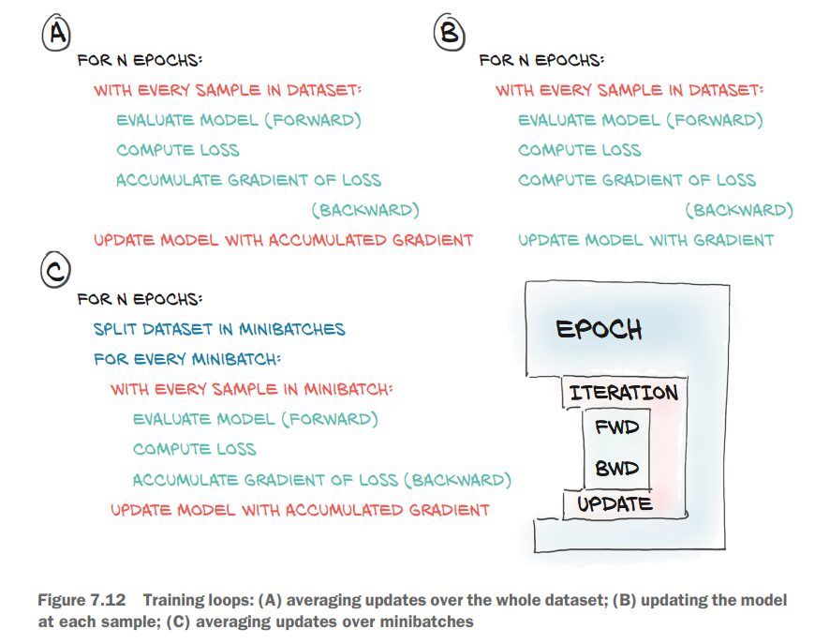
my humble ML course

Slide 8
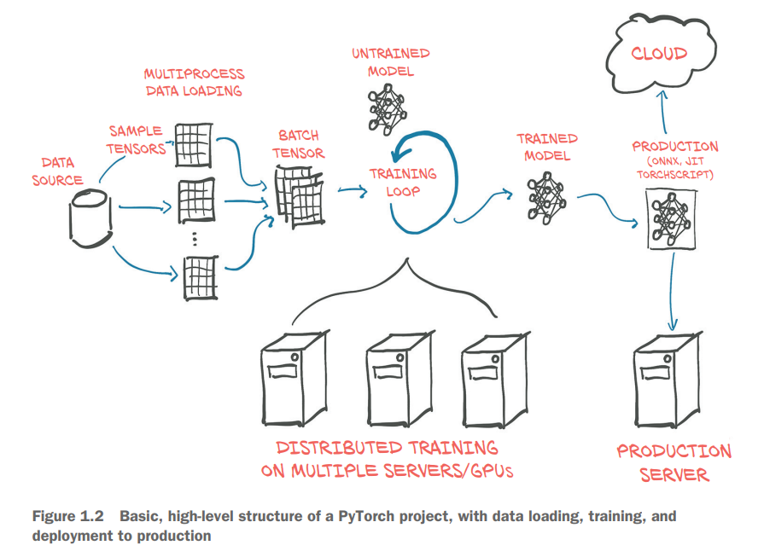
my humble ML course

Slide 9
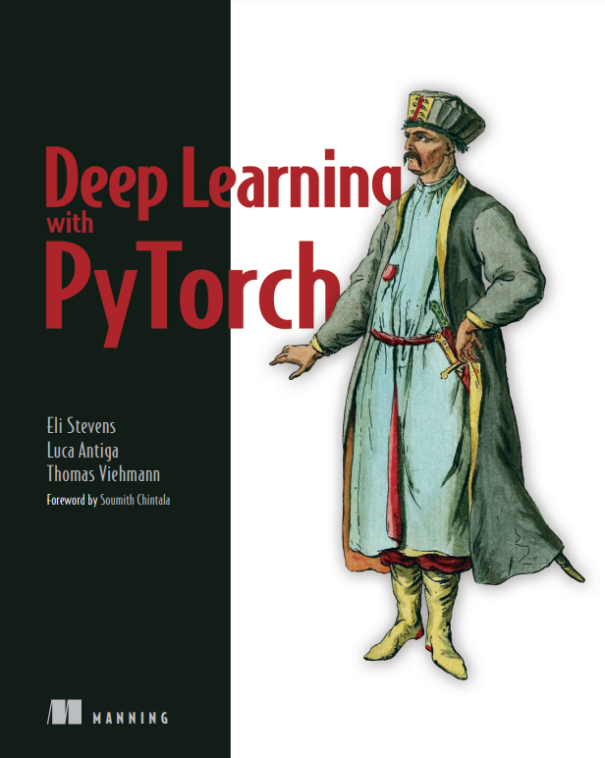
C11 – CNN
my humble ML course

Slide 10
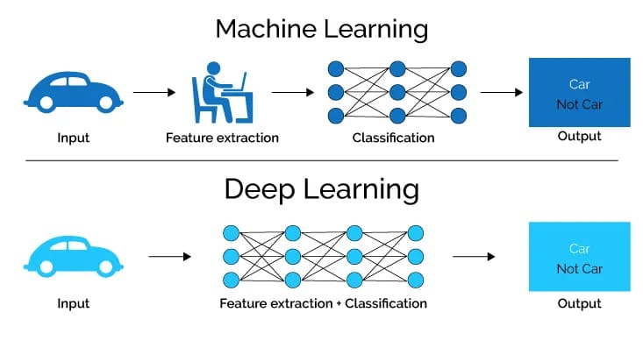
my humble ML course

Slide 11
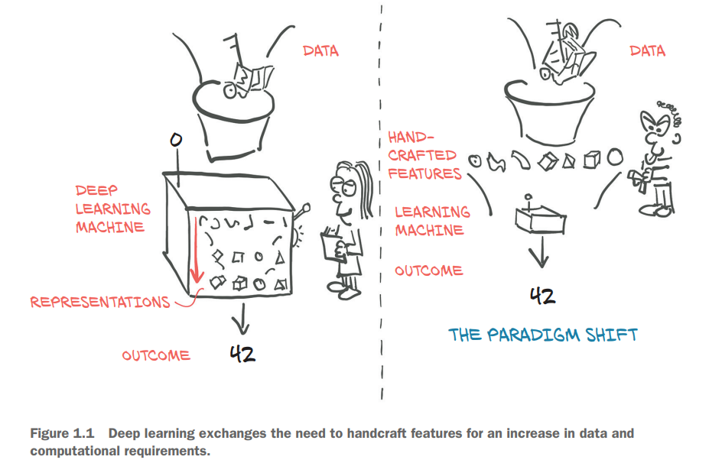
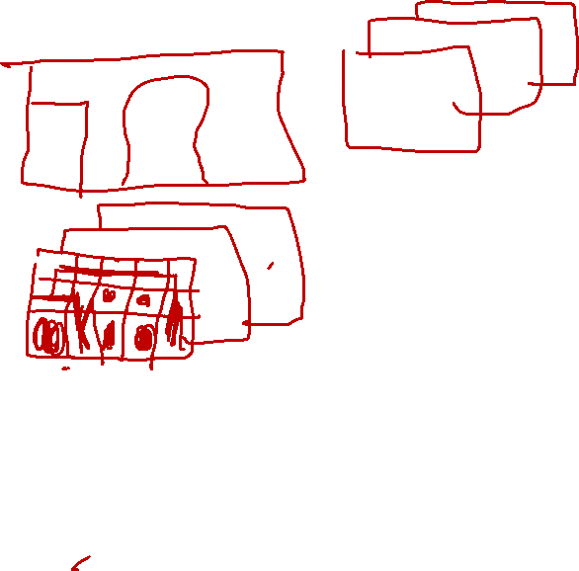
my humble ML course

Slide 12
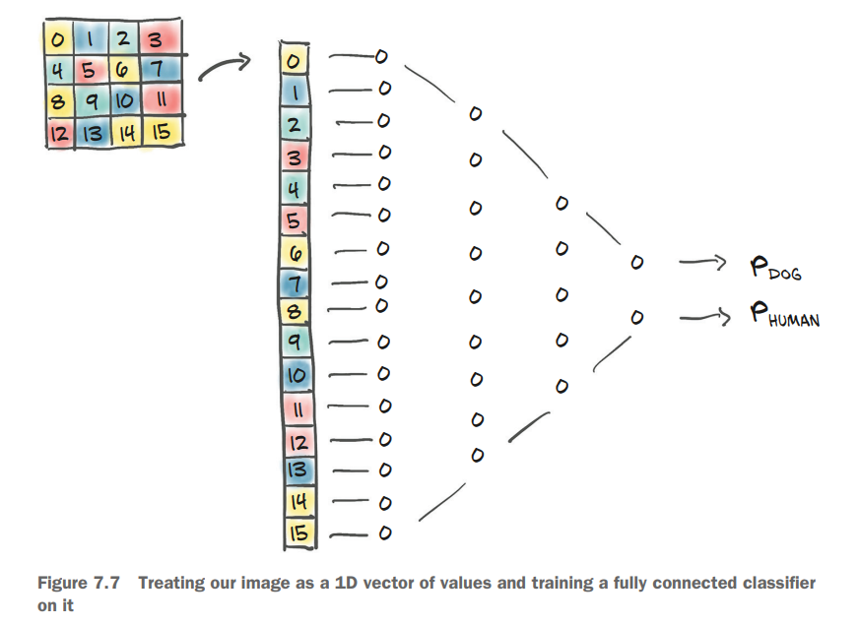
my humble ML course

Slide 13
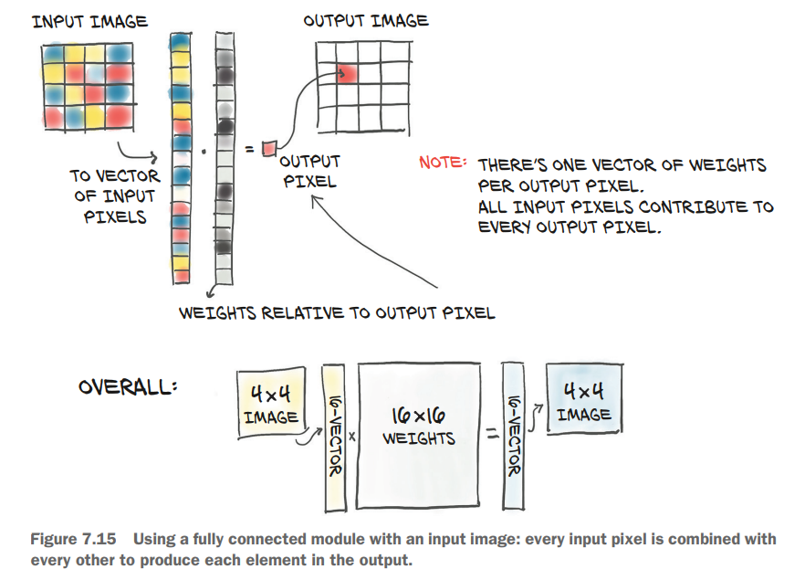
my humble ML course

Slide 14
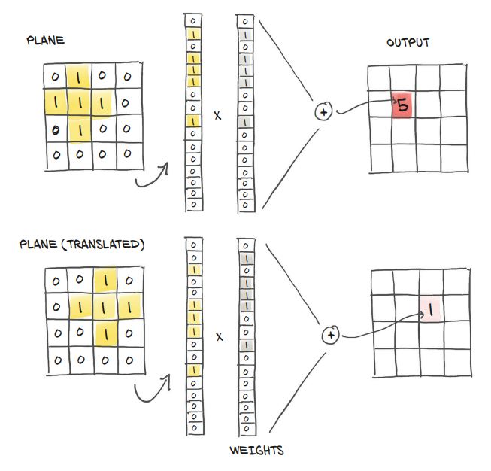
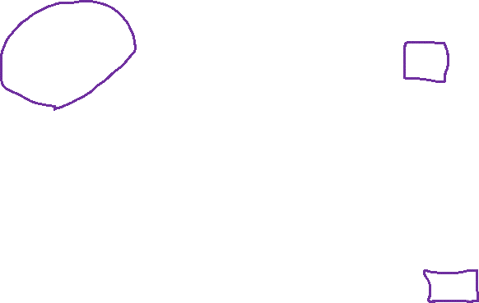
my humble ML course
Notes:
Figure 7.16 Translation invariance, or the lack thereof, with fully connected layers

Slide 15
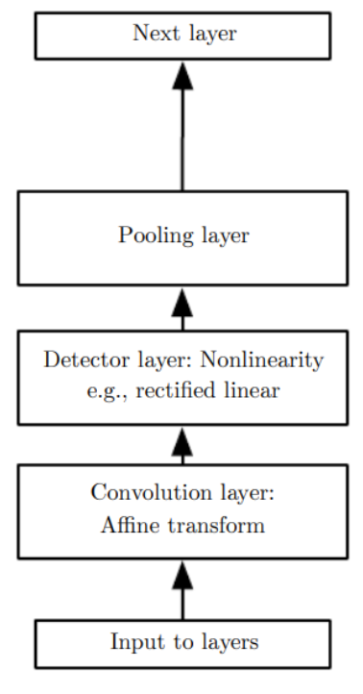
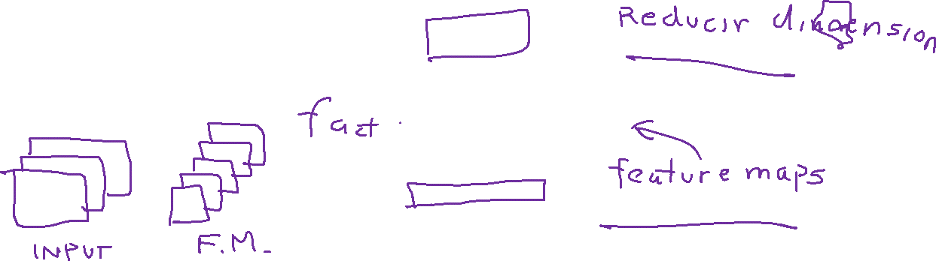
my humble ML course
Convolutional NN layer
Notes:
Figure 7.16 Translation invariance, or the lack thereof, with fully connected layers

Slide 16

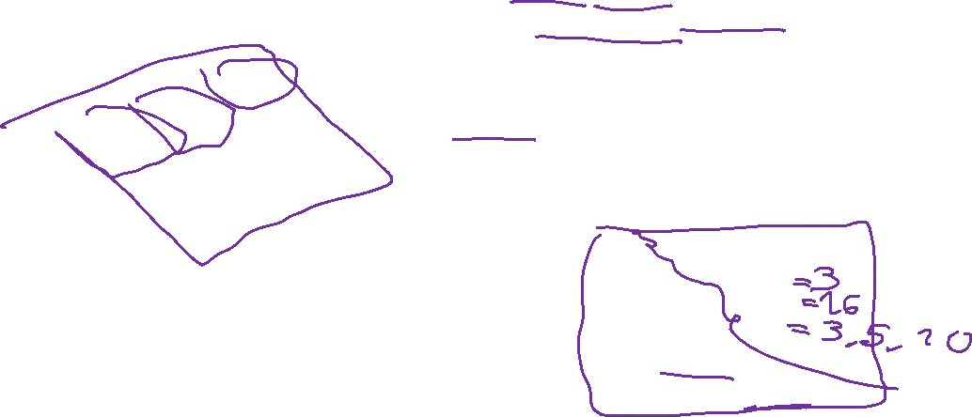
my humble ML course
Convolution
Kernel
INSPIRATION: How to extract features with location information?
INPUT: image or batch
OUTPUT: new channel/feature map
CONSIDERATIONS:
Kernel values are learned through backpropagation.
Convolution operation forms many-to-one relationship.
Convolution is invariant to translation
class torch.nn.Conv2d(
in_channels,
out_channels,
kernel_size,
stride,
padding
)
Image
Notes:
Kernel concept
Matriz de pesos que se deliza sobre la entrada de la capa convolucional
Conjunto de pesos que se utilizan para detectar patrones especificos en la entrada.
Element-wise multiplication between the input matrix and the kernel matrix.
A convolution operation forms a many-to-one relationship.
Dependiendo del kernel ciertos pixeles se van a estimular, y otros se van a inhibir

Slide 17
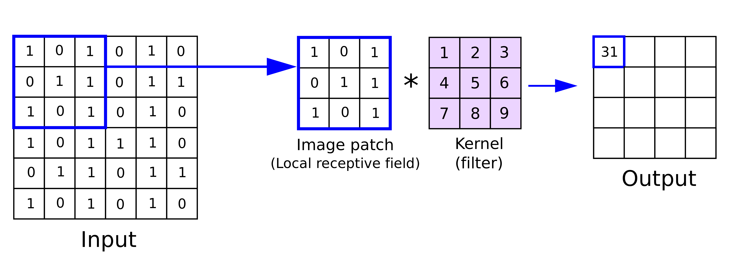
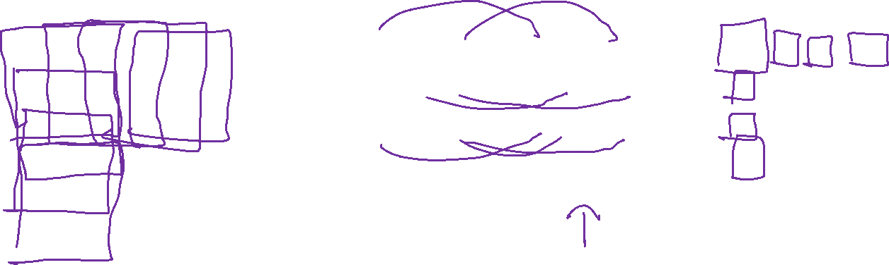
my humble ML course

Slide 18
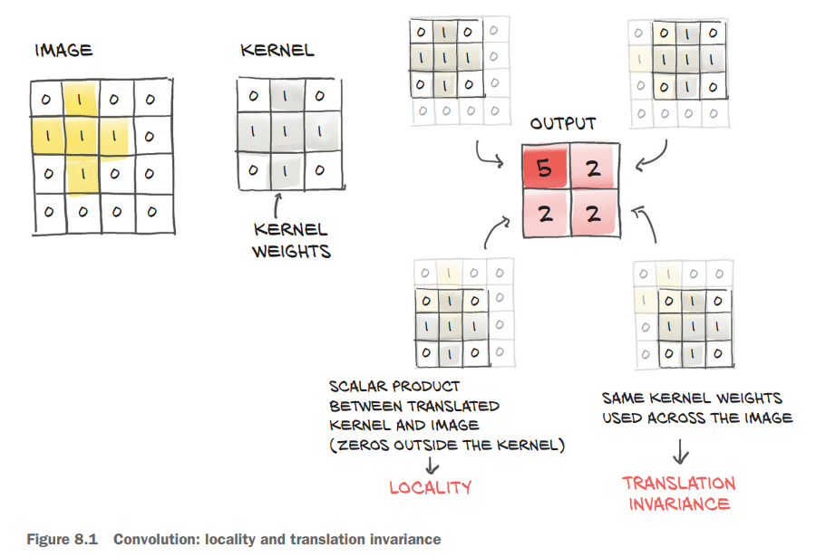
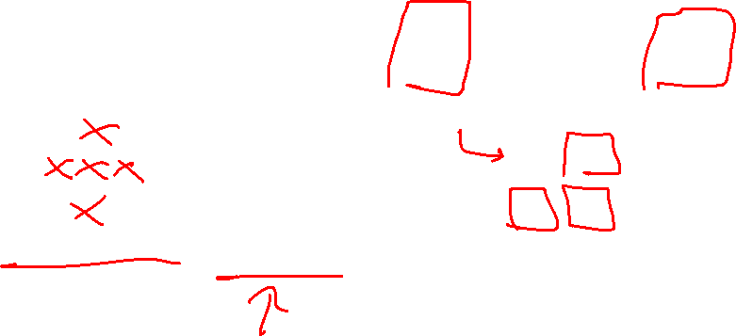
my humble ML course

Slide 19
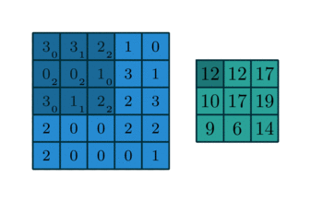
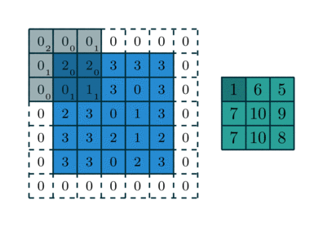

my humble ML course
torch.nn.Conv2d(
in_channels=1,
out_channels=1,
kernel_size=(3,3),
stride=1,
padding=“valid”
)
torch.nn.Conv2d(
in_channels=1,
out_channels=1,
kernel_size=(3,3),
stride=1,
padding=“same”
)
without padding
with padding
[(L − K + 2P)/S] + 1
L = Width or Height
Notes:
what is the difference between padding valid and padding same in PyTorch?

Slide 20


my humble ML course
torch.nn.Conv2d(
in_channels=3,
out_channels=1,
kernel_size=(3,3),
stride=1
)

Slide 21
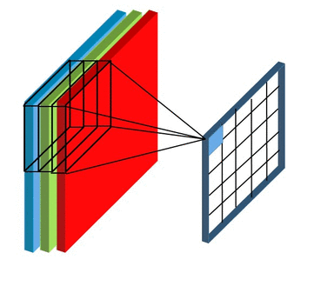
my humble ML course
torch.nn.Conv2d(
in_channels=3,
out_channels=1,
kernel_size=(3,3),
stride=1
)

Slide 22
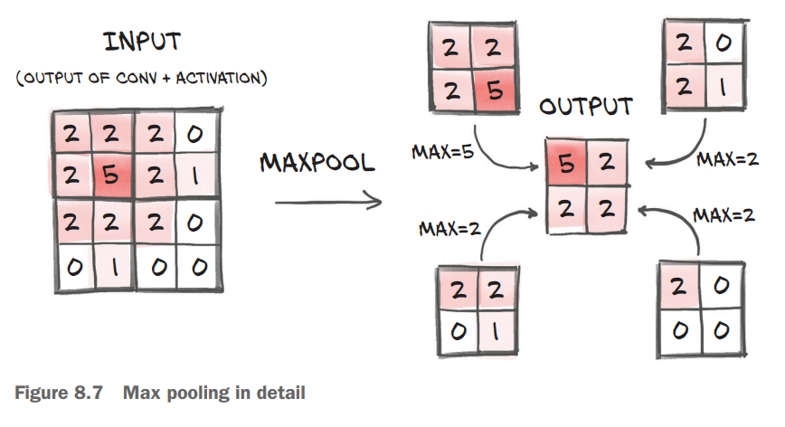
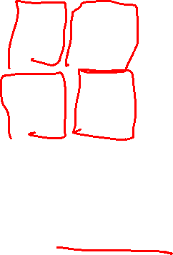
my humble ML course

Slide 23
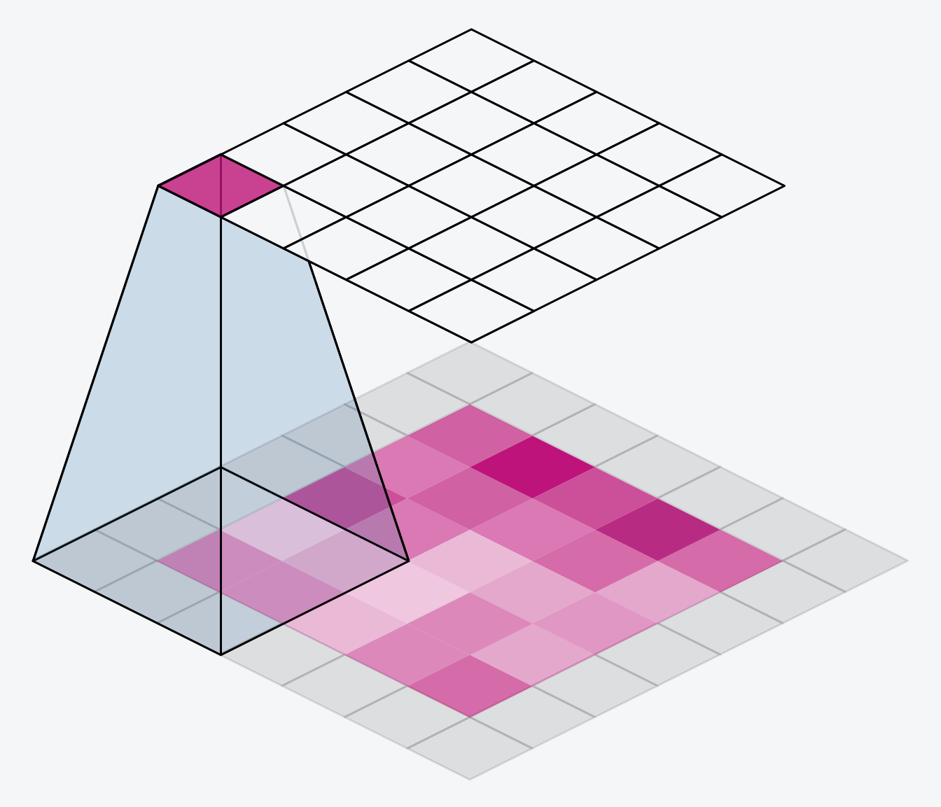
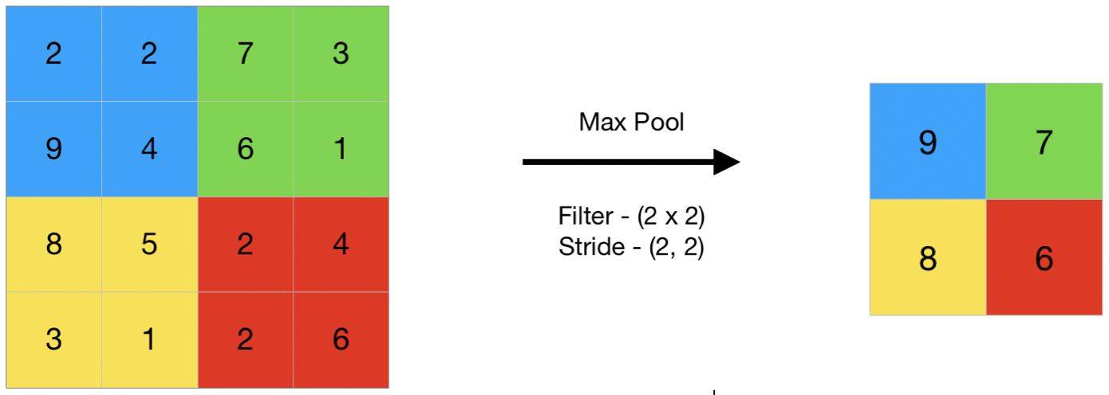
my humble ML course
Pooling (downsampling)
Notes:
Max Pooling

Slide 24
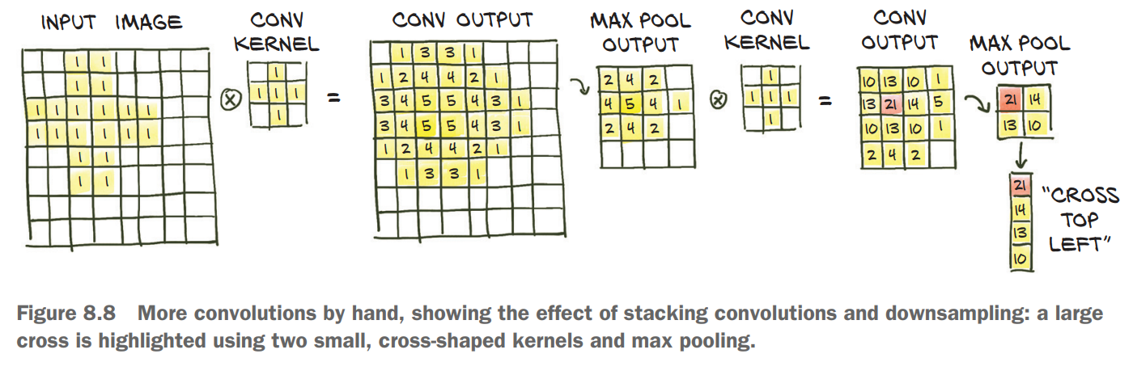
my humble ML course

Slide 25
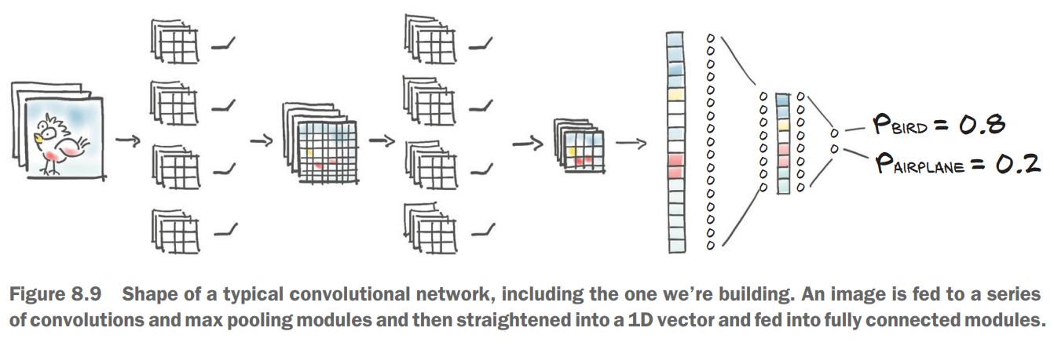
my humble ML course

Slide 26
my humble ML course
Bibliography
https://www.learnpytorch.io/00_pytorch_fundamentals/
https://www.notion.so/Machine-Learning-576820d3141640b7b095501d4e403429
https://www.notion.so/2022-1-f6340fba2c1d45dda494920cd73c9adf
https://lightning.ai/docs/pytorch/stable/notebooks/course_UvA-DL/
https://uvadlc-notebooks.readthedocs.io/en/latest/index.html
https://isip.piconepress.com/courses/temple/ece_4822/resources/books/Deep-Learning-with-PyTorch.pdf
https://poloclub.github.io/cnn-explainer/
https://drive.google.com/drive/u/0/folders/1X3AjOQ2G7NZO3U_0KGYzPXex49vx3Iy-
https://www.baeldung.com/cs/neural-networks-conv-fc-layers
https://builtin.com/machine-learning/fully-connected-layer
https://medium.com/swlh/fully-connected-vs-convolutional-neural-networks-813ca7bc6ee5
https://towardsdatascience.com/inside-convolutional-neural-network-e1c4c1d44fa2

